Slide 1

Optimizing Agricultural Practices: A Case Study on Machine Learning-Driven Crop Recommendation Systems

Slide 2

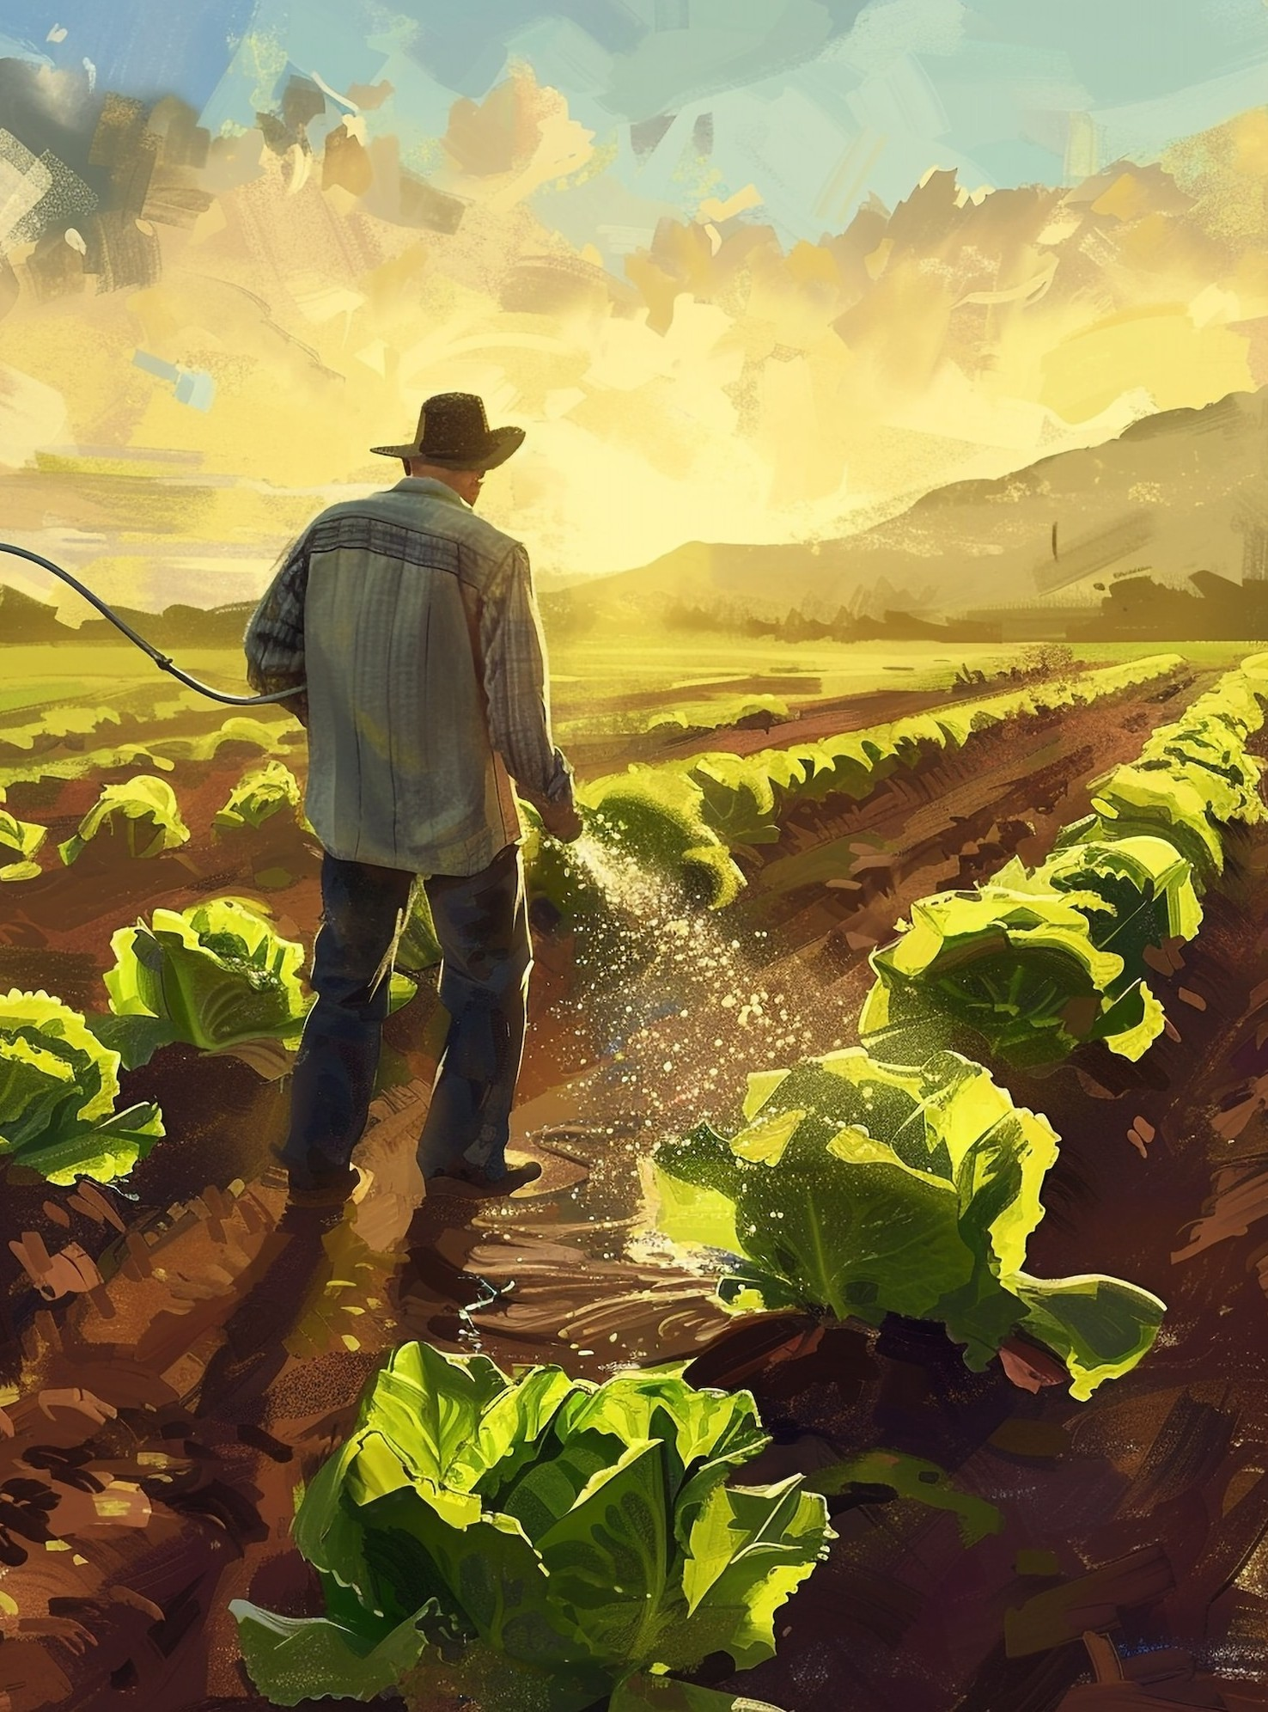

Introduction to Crop Recommendation
In this presentation, we explore machine learning-driven crop recommendation systems that enhance agricultural practices. These systems utilize data analytics to provide farmers with tailored crop suggestions, optimizing yield and resource usage. Understanding this technology is crucial for sustainable agriculture.

Slide 3






Importance of Crop Recommendations
Eective crop recommendations are vital for improving crop yields and ensuring food security. By leveraging machine learning, farmers can make informed decisions based on climatic conditions, soil health, and market demand,
ultimately leading to increased productivity.

Slide 4


Machine Learning Basics
Machine learning involves algorithms that learn from data to make predictions or decisions. In agriculture, these algorithms analyze historical data to identify paerns, helping to recommend the most suitable crops for speciﬁc conditions, enhancing eiciency and sustainability.

Slide 5




Data Sources for Recommendations
Successful crop recommendation systems rely on diverse data sources, including weather paerns, soil characteristics, and historical crop performance. Integrating data from satellite imagery and IoT devices further enhances the accuracy of recommendations, ensuring farmers receive timely insights.

Slide 6



Case Study Overview
This case study focuses on a speciﬁc region where machine learning-driven recommendations were implemented. The system analyzed local agronomic data to suggest optimal crops, resulting in improved yields and reduced resource wastage, demonstrating the practical beneﬁts of technology.

Slide 7

Results and Impact
The implementation of the crop recommendation system led to a signiﬁcant increase in crop yields and farmer income. By adopting data-driven practices, farmers reported improved resource management and reduced environmental impact, showcasing the transformative power of machine learning in agriculture.

Slide 8


Challenges and Limitations
Despite its advantages, machine learning in agriculture faces challenges such as data quality, accessibility, and the need for continuous model updates. Addressing these limitations is essential for maximizing the eectiveness of crop recommendation systems and ensuring widespread adoption.

Slide 9

Conclusion and Future
Directions
In conclusion, machine learning-driven crop recommendation systems represent a signiﬁcant advancement in agricultural practices. Future developments should focus on enhancing data integration and accessibility, ensuring that all farmers can beneﬁt from these innovative solutions for sustainable agriculture.

